Slide 1

The Right to be Heard:
Review of the Quality of Independent Mental Health
Advocate Services in England
Stephanie de la Haye, Karen Newbigging and Dr Julie Ridley
Representing IMHA Research Team
Notes:
Karen

Slide 2
Why does this matter?
It’s the law
Recovery focus
Health and Social Care Act 2012
  Shift in commissioning arrangements
Best practice
  Self-determination
  Co-production?
  Empowerment?
  Collaborative relationships

Slide 3
Seminar Purpose
Describe study
Present key findings
Discuss implications & recommendations

Slide 4
What is an IMHA?

Slide 5
An IMHA is…
A specific type of mental health advocate, granted specific roles and responsibilities under the 2007 Mental Health Act (MH Act).
To help qualifying patients understand the legal provisions to which they are subject, and the rights and safeguards to which they are entitled, and help those patients exercise their rights.
Qualifying patients - IMHAs work mainly with patients detained in hospital under the MH Act, also with people on Community Treatment Orders or Guardianship.

Slide 6
IMHA Role
Providing information, informing of rights, signposting:
    “She explained to me I could go with a … I never knew I could go through with the tribunal, do you understand, that was like kryptonite in my ears.” IMHA partner (Acute ward)
Support to prepare, attend, after meetings (CPA, Tribunals, Managers Hearings, Ward rounds)
Accessing patients notes/records
Non instructed advocacy – less common.
Notes:
Complex role
Central is providing information about
Detention and rights under the MH Act
Explaining what happens at Tribunals, CPAs etc
Signposting to other services
Facilitating access to info eg about drugs and effects
Supporting users at meetings, helping them prepare sometimes attending, debriefing afterwards. Varied between the case study areas as to which meetings attended, in some areas IMHAs didn’t attend many Tribunals and in others they did.
Not much evidence of accessing patients notes and some discomfort with that among MH professionals who were wary of confidentiality
Non instructed advocacy was less common and IMHAs varied in their feeling about this, goes against the grain of advocacy for some, whereas others also IMCA and had been trained so felt more comfortable doing non instructed.

Slide 7
PREVIOUS RESEARCH
Scant!
One study comparing outcomes for statutory and person-centred advocacy (Rosenman et al, 2000)
Two main studies looking at mental health advocacy and BME communities (Rai-Atkins et al, 2002; Newbigging et al, 2007)
CQC and Tribunal service identified access problems and lack of staff understanding
MH Alliance and A4A identified weak commissioning
with an impact on provision for BME communities

Slide 8
Research background
Commissioned by Department of Health in 2010, this research aimed to review the extent to which IMHA services in England are providing accessible, effective and appropriate support, and to understand better the factors that influence the quality of provision.

Slide 9
Service User Involvement
Research Team
Reference Group
Project Advisory Group
Partnership Orgs

Slide 10
Methodology
Complex multi-method study using qualitative and quantitative data
Two Phases

Slide 11
Phase 1
Phase 1
What do quality IMHA services look like?
Focused literature review
11 Focus groups
Expert panel to review and refine quality indicators
4 Shadow visits with IMHAs

Slide 12
Phase 2
Phase 2
What is the experience, quality and outcomes of IMHA services?
8 NHS Trust case studies
IMHA services questionnaire
Documentary analysis
Analysis of records
Service users questionnaire
Survey of independent providers
Interviews with 214 stakeholders including 90 qualifying patients

Slide 13
STUDY Participants – TOTAL 290

Slide 14
SERVICE USER PARTICIPANTS
  Total of 108
  Participated in focus groups plus interviews
  Interviews were undertaken with 90 qualifying patients (59 IMHA users, 31 non-users)
    Age range: 15-74 years
    Ethnicity: 30% from BME communities
    Over half (57.5%) had more than five years contact with less than ten per cent (8.8%) under one year of contact
    Half (50.0%) had been sectioned three times or more compared with a quarter (26.3%) who had been sectioned once

Slide 15
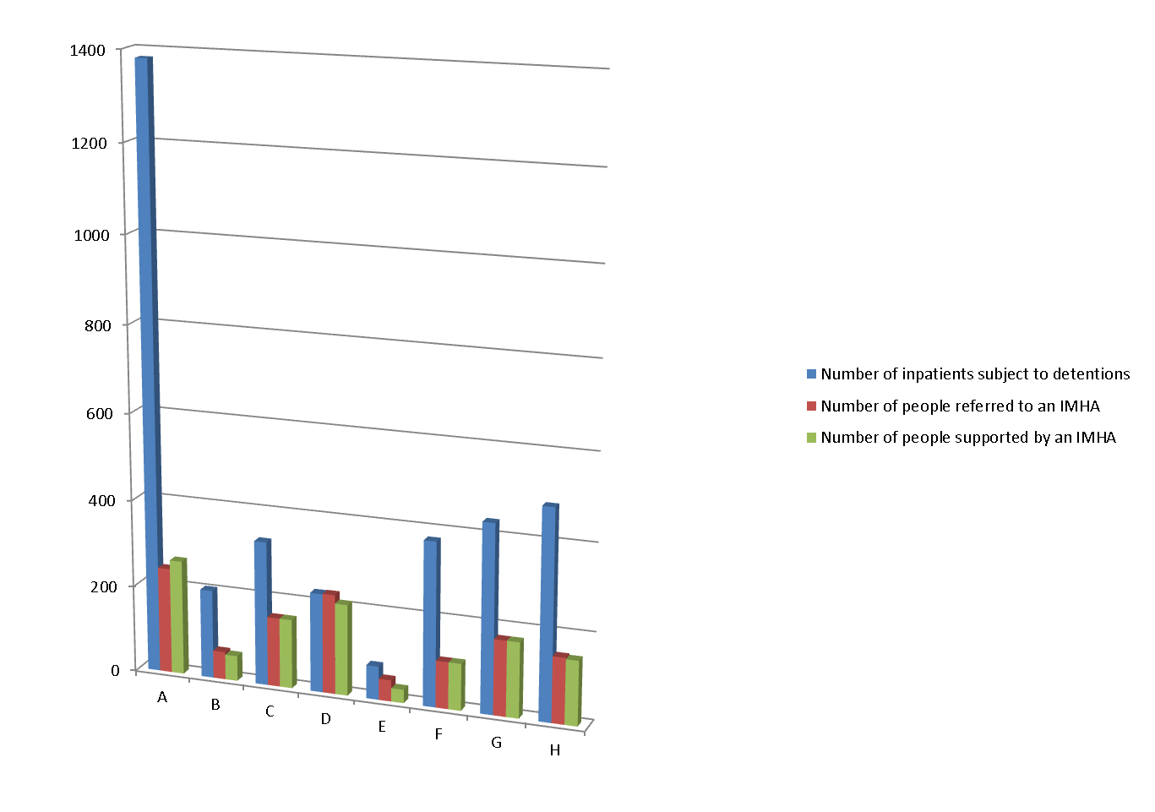
Access and referral to IMHA services

Slide 16
Access for people on CTOs
Case study | People using IMHA as % of number of qualifying patients detained in hospital | People using IMHA as % of qualifying patients on CTOs
A | 19 | 5
B | 33 | 25
C | 48 | 0
D | 92 | N/A
E | 33 | Data not available
F | 57 | 11
G | 40 | 55
H | 40 | 20

Slide 17
Accessibility
Less than half entitled were accessing it
Poor access for some groups
Those requiring advocacy most making least use – “hard to reach, easy to ignore”
IMHA services not always well advertised
Understanding central to access
Notes:
Less than half qualifying patients entitled to IMHA support were accessing it
Poor access for various groups - people on CTOs, BME communities, children/young people, older adults, Lesbian Gay Bisexual & Transgender, people with sensory impairment, and people with learning disabilities
Those who require advocacy most were making least use of it – “hard to reach, easy to ignore”
IMHA services were not always well advertised
Understanding of IMHA was central to determining access

Slide 18
Meeting Diverse Needs?
Low uptake among young people, older people, BME groups
BME issue construed as language issue
Little evidence of needs assessment directing commissioning
IMHA services confident about their capacity to respond to diversity
IMHA workforce mostly female (73%) and white (84%)
Few small local advocacy services commissioned to provide IMHA most were well established mainstream organisations
Varied access by people with learning disabilities
“It’s not for me!”
Institutionalised racism?
One size fits all?
Notes:
June

Slide 19
Range of Advocacy Provided

Slide 20
Multiple Advocacy Roles
3 out of 4 IMHAs also generic advocates
Fewer were IMCA
“I think it’s an advantage to the patients that I can do both because I don’t then have cut off points where I say `oh well you’re voluntary now so I’m not advocating for you anymore’... because we do community … if I’m doing something for somebody and they’re discharged or they leave the unit, I will continue advocating for them until their issues are resolved or they’re happy and satisfied...” (IMHA)

Slide 21
Variation in Number & Type of IMHA Provider
Case Study Site | A | B | C | D | E | F | G | H
Number of IMHA providers | 3 | 4 | 1 | 2 | 2 | 1 | 5 | 5
Notes:
Wide variation in numbers, size and type of advocacy services providing IMHA
Not only was it the number of IMHA providers in an area that differed across the study sites, but the type of advocacy organisations also varied. For instance, three of the five IMHA providers in site H were local branches of large national organisations, one was a regional charity, and another was a national specialist children and young people’s organisation. In contrast, all four IMHA services in Site B were delivered by local advocacy bodies serving distinct geographical patches.
The interface between advocacy and mental health services is therefore more complex in some areas than others because there are multiple providers covering diverse populations, which is likely to have a bearing on service users’ and professionals’ knowledge of relevant IMHA providers and consequently, on the frequency of referral.

Slide 22
Non IMHA Users’
Understanding of IMHA
Had not heard about IMHA
Thought it was linked to mental health services or local authorities
Confused it with ICAS or support worker role
Assume role is to provide support generally including with complaints
Notes:
“Someone on my side, opening up options”
Listened to
Not judged
IMHA is independent
Voice and representation: in meetings
Safeguarding rights
Rebalancing power
Maintaining the status quo

Slide 23
IMHA Users Said….

Slide 24
Understanding of IMHA advocacy by mental health staff
Framing staff role in terms of being the “patients advocate” and thus IMHA understood as best interests advocacy
Training generally superficial
% of mental health staff asked who were able to recall name of IMHA or of the service | Confusion with IMCA | % of mental health staff interviewed understand that it is an obligation | % of mental health staff interviewed that knew IMHAs can access records
15 -100% but was influenced by organisational changes | 18-45% but community staff with little contact | 20-86% understand it is an obligation | 10-30%
Notes:
Some staff unable to name local IMHA or service
Community-based professionals most likely to confuse with IMCA role
Not all mental health professionals understood their obligation to promote IMHA
Fewer professionals understood that IMHAs can access records
Training on IMHA generally superficial, with exception of AMHPs

Slide 25
“They are good bridge and especially in some of the cases … where we need to know that somebody had talked with the patient and expressed the views, they find advocacy to be very helpful and very useful….” (Psychiatrist)
“I think that IMHA are meant to be able to put the patient’s point of view across and to support the patient when they haven’t really got so much of a voice ….” (IMHA user)
“That’s why I’ve described her as WD40…it’s been necessary for me to have her to almost smooth over some of these disjointed problems that occur from me being shoved around.” (IMHA user)

Slide 26
“There have been a number of [cases] where I think the advocate’s pushed so strongly for the young person that actually it might have begun to have a negative consequence really and a degree of antagonism can build up …and that renders advocacy less useful…which I think is a great shame because it’s an important service that needs to be there for young people”. (CAMHS Psychiatrist)

Slide 27
Impact of IMHA Support
Service users highly satisfied & most felt they benefited
Key distinction found between process impact & tangible (action-orientated) outcomes
Most impact in relation to process, less on increased participation in decision making.
Notes:
June

Slide 28
Process Impact | Outcomes Impact
Ensuring service users have a voice Increasing service users’ confidence Increasing service users’ sense of well being Someone alongside, on your side Providing information to increase understanding Supportive, empowering approach Performing an important safeguarding function | Service users’ understanding and knowledge of rights and of treatment increased Helped towards service users’ recovery Service users empowered to exercise rights Coming off Section Service user participation in decisions affecting their care and treatment Acceptance of status quo Successful resolution of complaints increased

Slide 29
“It is important to have someone to talk on your behalf if you can’t. It helps your confidence. I felt more comfortable to know that someone really understands and cares about you, alongside you, not just a stereotype.” IMHA user
“Even though the outcome for the patient might not be always what they want, at least the processes are there to try and enable them to exercise some influence on the processes that are going on rather than it just being a sort of like a done deal as it were...” Ward manager

Slide 30
“It’s not changed anything that’s happening here at all… [But] it’s made me feel better within myself because people are treating me as a human being and not a bit of dirt under their feet… It gives you confidence within yourself.”
IMHA user

Slide 31
CONCLUSIONS - ACCESSIBILITY
Less than half the numbers of qualifying patients are accessing IMHA services
Access for people on CTOs particularly problematic
Those who require the service most, making least use of it
Need for staff training critical to address potential gatekeeping
Availability reflects local investment and effectiveness of service organisation

Slide 32
CONCLUSIONS - APPROPRIATENESS
Those who accessed service usually valued the input even if it did not lead to changes in care and treatment
Emphasis towards information and voice rather than active participation in decision-making
Ambivalence about non-instructed advocacy
Little evidence that IMHA providers have comprehensively taken steps to provide for the diversity of qualifying patients
  Are people with specific needs getting a second class service?
IMHA alongside generic mental health advocacy seen as a function rather than a role leading to greater flexibility

Slide 33
CONCLUSIONS - EFFECTIVENESS
Difficult to evaluate on data available
Distinction between process outcomes and impact outcomes and not necessarily related
Consideration of a standardised approach, which included both process and impact measures
And finally…..
Quality of IMHA services is influenced by the quality of commissioning and the mental health context within which these services are delivered

Slide 34
Key Recommendations
Core values about rights and recovery need underlined
Qualifying patients should get an IMHA automatically
Different groups who find it hard to get an IMHA need to be top of the list
Non-instructed advocacy needs to be researched
Information about right to access and uptake needs to be kept
Money, time and effort needed to ensure suggestions happen.
Service user need to take part in how IMHA services planned and go forward.
Notes:
Recommendations made to -
Government
CQC
Commissioners
Mental Health Services
IMHA providers
Service users
all need to remember the core values about rights and recovery.
We think that patients should get an IMHA automatically.
Different groups who find it hard to get an IMHA need to be top of the list. A close eye should be kept so they get the service they need.
Non-instructed advocacy needs to be researched.
Information that professionals keep must to be clear and keep up standards.
Money, time and effort are needed to ensure that these important suggestions happen.
Patients and ex-patients need to take part in how these services are planned and go forward.

Slide 35
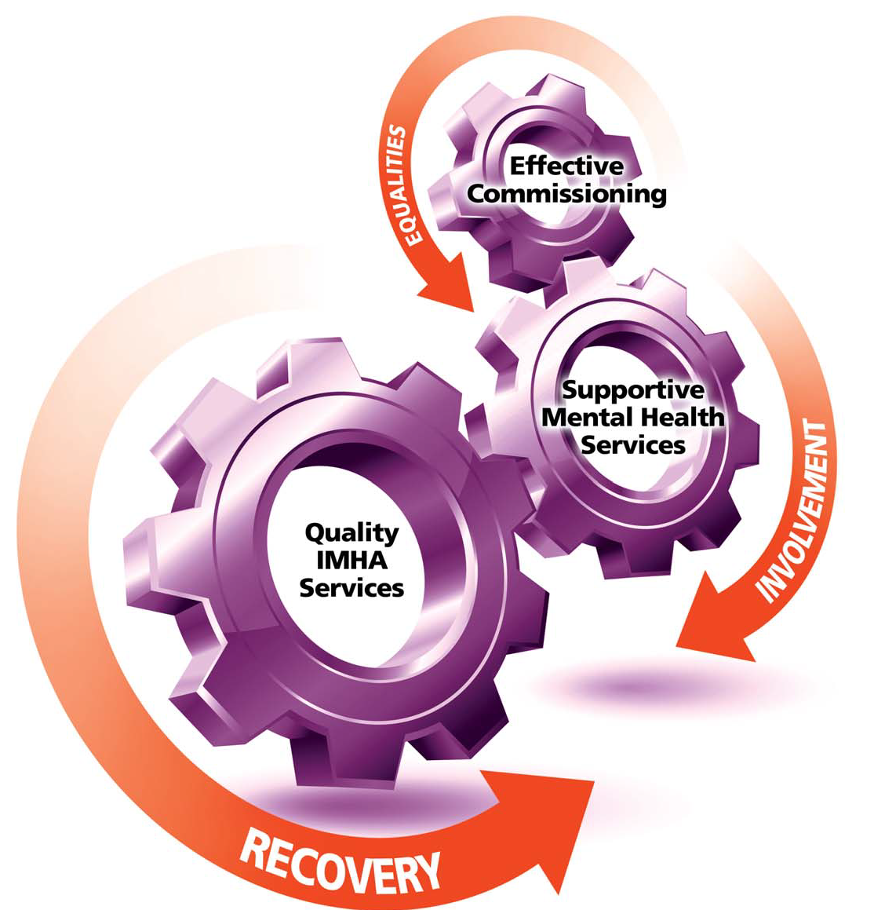
QUALITY IMHA SERVICES
Notes:
Are easily accessible
Are services in which the service user has confidence and trust
Enable service users to express their views
Ensure service users views are heard
Potentially influence decisions about their care and treatment under the MH Act
Ultimately support the journey to recovery.

Slide 36
The Right to Be Heard: Review of Independent Mental Health Advocate (IMHA) Services in England
(2012) by
Karen Newbigging, Dr Julie Ridley, Dr Mick McKeown, Karen Machin and Dr Dina Poursanidou
Laura Able, Kaaren Cruse, Paul Grey, Stephanie de la Haye, Zemikael Habte-Mariam, Doreen Joseph, Michelle Kiansumba and June Sadd
The full Report and a Summary Report will be published June 2012
After 21 June launch, Reports available at http://www.uclan.ac.uk/schools/school_of_health/mhc_completed_projects.php
Notes:
Karen

Slide 37
GROUPWORK TASK
How can you translate the findings of the IMHA research into day to day practice and organisational change?
Consider –
Your own practice
Current policy
Your organisation
S.W.O.T analysis in relation to the effects of the Health & Social Care Act 2012

