Slide 1
Covid-19: The Impact on Families Experiencing Poverty and The Role of Community Psychology
Cumbria Community Foundation AGM
4th December 2020
Suzanne Wilson, Research Fellow in Social Inclusion and Community Engagement

Slide 2
Covid-19 Related Research and Work
West Cumbria Child Poverty Forum: Leading focused child poverty campaigns including a rapid response paper in May, a webinar in October and a follow up paper in December 2020 (Wilson, 2020a; Wilson, et al., in press).
British Psychology Society’s Working Group on Community Action and Resilience following Covid-19: Contributing to a number of publications on the subject, such as ‘Psychological insights for facilitating community resilience to respond to consequences of the Covid-19 pandemic’ (Dury, et al., 2020).
Central Government: Submitted a number of pieces of evidence to the UK House of Common’s Education Select Committee, all of which have been published by the UK Government (Wilson, et al., 2020a; Wilson, et al., 2020b). Provided oral evidence on white working-class families and the of the community in educational attainment.
Corona Diaries: Completing a book sharing the experiences of children in low-income communities which will be followed by workshops in primary schools in West Cumbria and Northumberland.
Other publications relating to the impacts of Covid-19 on young people and families include an article in The Conversation (Wilson, 2020b), contributing to the European Federation of Psychologists' Associations' Support Hub about COVID-19 Crisis (Wilson, 2020c), and reflective piece calling for opportunities for young people to enact their citizenship during and after the crisis (Wilson, 2020d).

Slide 3
The Secondary Impact of Covid-19: Worsening Child Poverty
Children experiencing poverty are expected to suffer disproportionality from economic and social impacts of the measures needed to contain the pandemic (Save the Children, 2020).
Younger households, households with children and households with lower levels of education are the most likely to fall into poverty as a consequence of Covid-19 (OECD, 2020).
“Children are not the face of this pandemic. But they risk being among its biggest victims” (UN, 2020).
Child Poverty in the UK
  In the UK 200,000 more children expected to experience poverty, along with 4.2 million children who were living in poverty before the pandemic (Institute for Public Policy Research, 2020).
  Before the pandemic 30% children were experiencing poverty, with 66% coming from families were at least one member of their family worked (End Child Poverty, 2020).
Notes:
Internationally, children in poverty are expected to suffer disproportionality from economic and social impacts of the measures needed to contain the pandemic (Save the Children, 2020), with the OECD predicting that younger households, households with children and households with lower levels of education are the most likely to fall into poverty as a consequence of Covid-19 (OECD, 2020). Despite the clear evidence, little evidence can be seen of active efforts to include marginalised children, such as those experiencing poverty or from low-income families, in the recovery effort. As stated by the UN, “Children are not the face of this pandemic. But they risk being among its biggest victims” (UN, 2020).

Slide 4
Child Poverty in West Cumbria, UK
A county of two halves:
Cumbrian Coast | Lake District National Park
Predominately industry Pre Covid situation: Existing poverty Existing vulnerable groups | Predominately tourism and leisure Pre Covid situation: Affluent areas Newly vulnerable groups
Notes:
Economically, Cumbria presents a complex picture. Areas dependent on tourism, principally Eden and South Lakeland, have experienced by far the most profound impact on their local economies. On the other hand, West Cumbria has been somewhat less impacted by the economic consequences of Covid-19 and the consequent restrictions due to the number of people employed in the nuclear industry. The August figures show that since March (which is treated as the pre-Covid position) the increased in households on Universal Credit has risen in West Cumbria below then the national average (Department for Work and Pensions, 2020).

Slide 5
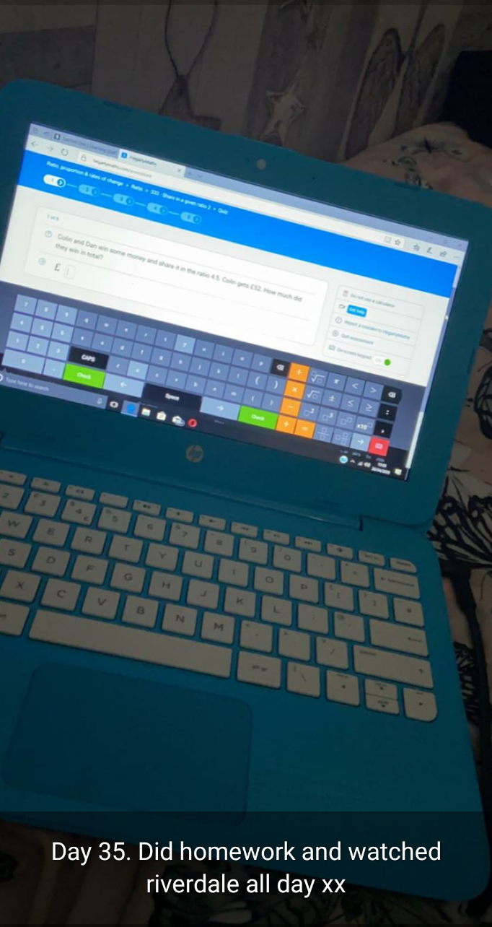
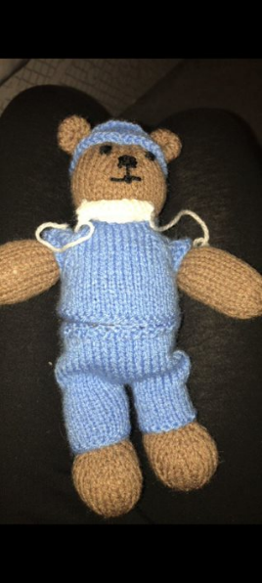
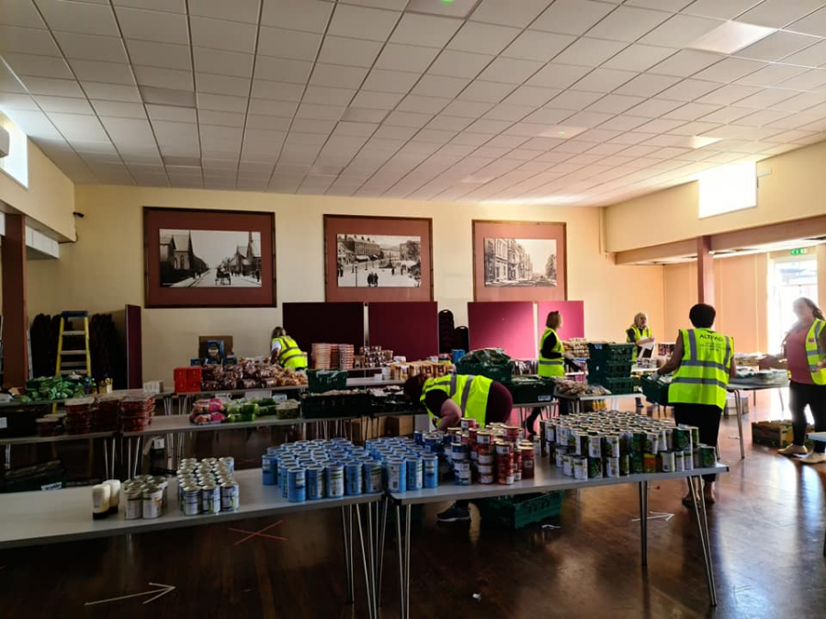
Child Poverty in West Cumbria: Through the Eyes of Professionals
Child Poverty Rapid Response Paper (May 2020)
Wellbeing
Education
Hardship
Child Poverty Webinar (October 2020) & Follow Up Report (December 2020)
Early Years
Food insecurity
Digital exclusion
Health and wellbeing
Notes:
In May 2020 West Cumbria Child Poverty Forum published a rapid response paper highlighting the issues affecting families during lockdown (West Cumbria Child Poverty Forum, 2020). The key findings centred around three themes, wellbeing, education and hardship.
Wellbeing: Practitioners had expressed concerns about not only the physical safety of the very most vulnerable children and young people but were also worried about the emotional wellbeing of many children and young people across West Cumbria, particularly those with existing mental health needs/ issues.
Education: Schools and youth organisations were concerned about the impact of the extended school closures. In particular references to children living in households experiencing poverty they were particularly worried about access to IT, access to teachers (and positive, supportive role models) and the home learning environment.
Hardship: Organisations involved in the community response told us how concerned they were about food insecurity in families already experiencing poverty. They were also worried about the effect of the lockdown on low-income working families, many of whom would now be made unemployed or furloughed.
Child Poverty Webinar (October 2020) & Follow Up Report (December 2020) found that:
Early Years: Early years education was being significantly impacted upon, which has a lifelong impact on the educational trajectories of children.
Food insecurity: School provide details accounts of the financial hardship and food insecurity experienced by families who were just about managing before the pandemic.
Digital exclusion: Access to internet and IT equipment remains to be an issue, with the national Government not fulfilling their commitment to ensure all children have access to IT.
Health and wellbeing: Schools and services are providing mixed messages about the impact on health and wellbeing. Some children are showing great resilience, whereas other are returning to school presenting with significant anxiety.
The national context:

Slide 6
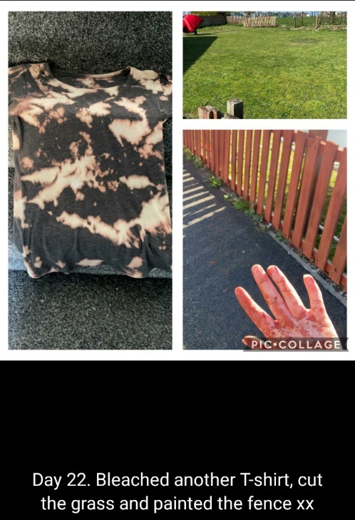
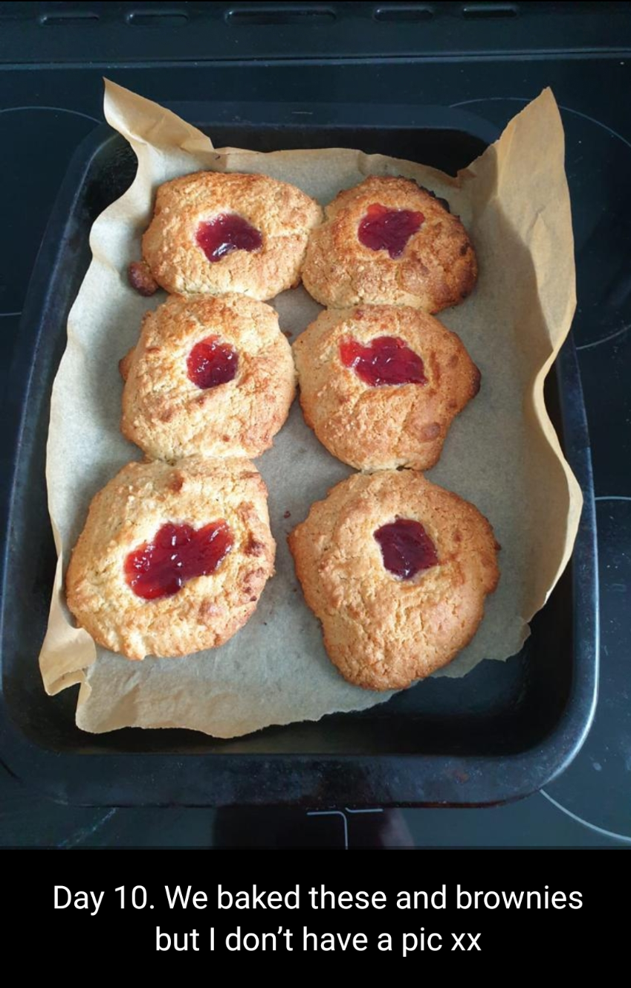
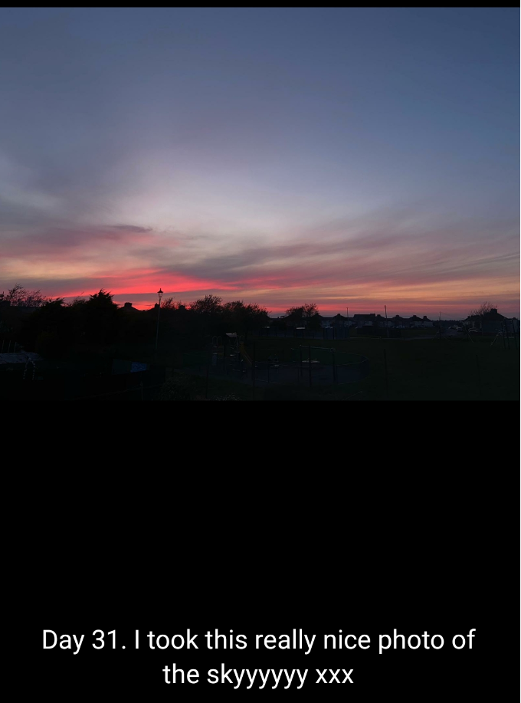
Child Poverty in West Cumbria: Through the Eyes of Children and Young People
Corona Diaries Book
The Virus
Family and Friends
Learning from Home
Exploring Outside
Getting Creative
Spreading Hope through Community Spirit
Back to School
Book to be launched March 2021.
School workshops and projects with local partners to follow.
Notes:
I am working with local families on a ‘Corona Diaries’ Book where children captured their experience during lockdown through poetry and poems:
The Virus: Children were worried about their elderly relative getting sick and missed their extended families.
Family and Friends: Children did spend more time with their siblings, engaging with them more than they usually would. Children did communicate with their friends using social media platforms, but they all experienced some distress in missing their friends.
Learning from Home: Children expressed mixed feedback regarding learning from, some enjoyed the break from teachers but others missed their friends. Most said that they felt the quality of education they were receiving was reduced during this time.
Exploring Outside: The first lockdown occurred during spring months, and the UK we had some great weather. Most children involved in the book spent a significant amount of time playing outside.
Getting Creative: Few parents in the families I was working with were key workers, or could work from home. As a result, they had more time to spend with their children, which was often spent baking or being creative in some way.
Spreading Hope through Community Spirit: The groups of children involved in the book aren’t’ necessarily presentative of all children experiencing poverty. These children were either already involved in a UCLan community research project or had parents involved in community activism. These children started their own community projects to help to wider community, such as creating art work to go in welfare parcels for the elderly or making activity booklets for other children in their communities.
Back to School: The children involved in this book adapted well to the turn to school, enjoying it at first and then returning to pre-Covid feelings of
The book to be launched March 2021, marking the one year anniversary of the first lockdown. This will be followed by school workshops where other children will be encouraged to reflect on their experience and got involved in some form of community activism in light of Covid.

Slide 7
Recommendations
  Organisations must work collaboratively to every child experiences food security.
  Digital exclusion is widening the attainment gap and must be addressed.
  Schools are key anchor institutions and should be viewed accordingly.
  Trust in the local expertise and ability of local community group by sharing power.
  Listen to, and respond to, the voice of the child.
  Champion the benefits of collaboration and data sharing.
WCCPF recommend the formation of a therapeutic community along these lines as a starting point:
"in order to realise their potential as individuals and active citizens, children require an environment that fosters personal growth. They need to form relationships with others in an atmosphere of trust and security, they need to be valued, accepted and supported by those around them and they need to take real responsibility for themselves, others and their environment" (Oxford Health Complex Needs Service, 2018).

Slide 8
References
Crowley, A., & Vulliamy, C. (2007). Listen up. Children and Young People Talk: About Poverty. Available at https://resourcecentre.savethechildren.net/sites/default/files/documents/4631.pdf (accessed on 15.6.19)
Department for Work and Pensions (2020). Universal Credit statistics: 29 April 2013 to 10 September 2020. Available at: https://www.gov.uk/government/statistics/universal-credit-statistics-29-april-2013-to-10-september-2020 [accessed on 07.11.2020].
Dury, et al., (2020). Psychological insights for facilitating community resilience to respond to consequences of the Covid-19 pandemic. British Psychological Society. Available at https://www.bps.org.uk/sites/www.bps.org.uk/files/Policy/Policy%20-%20Files/Facilitating%20community%20resilience%20to%20respond%20to%20consequences%20of%20Covid-19.pdf [accessed on 07.11.2020].
End Child Poverty (2020). Child Poverty in Your Area. Available at: http://www.endchildpoverty.org.uk/child-poverty-in-your-area-201415-201819/ [accessed on 07.11.2020].
Eurostat (2019). Statistics on young people neither in employment nor in education or training. Available at: https://ec.europa.eu/eurostat/statistics (accessed on 15.6.19)
Institute for Public Policy Research (2020). 1.1 million more people face poverty at end of 2020 as a result of coronavirus pandemic, finds IPPR. Available at [accessed on 22.11.20].
Ridge, T. (2011). The everyday costs of poverty in childhood: A review of qualitative research exploring the lives and experiences of low‐income children in the UK. Children & Society, 25(1), 73-84.
The Children’s Society (2016). Poor Mental Health: The links between child poverty and mental health problems. Available at: https://www.childrenssociety.org.uk/sites/default/files/poor_mental_health_report.pdf (accessed on 15.6.19)
Wilson, S. (2020a). Child Poverty: The impact of COVID-19 on families in West Cumbria. Available at: https://clok.uclan.ac.uk/33498/1/WCCPF%20Child%20Poverty%20and%20COVID-19%20May%202020.pdf [accessed on 07.11.2020].
Wilson, S. (2020b). Coronavirus aftermath: how do communities recover from trauma? The Conversation. Available at: https://theconversation.com/coronavirus-aftermath-how-do-communities-recover-from-trauma-134967 [accessed on 07.11.2020].
Wilson, S. (2020c). Community Renewal After Covid-19. In: European Federation Psychologists Association, Community renewal following COVID-19, 4 June 2020, Webinar.
Wilson, S. (2020d). Action for Youth Citizenship - A moral imperative. Available at: https://www.uclan.ac.uk/research/explore/groups/assets/action-for-youth-citizenship-suzanne-wilson.pdf [accessed on 07.11.2020].
Wilson, S., et al. (in press). Building a Therapeutic Community around Children Experiencing Poverty.
Wilson, S., et al. (2020a). Response to Parliamentary Select Committee on the impact of COVID-19 on Left behind white pupils from disadvantaged backgrounds: Call for Evidence. Available at: https://committees.parliament.uk/writtenevidence/5772/pdf/ [accessed on 07.11.2020].
Wilson, S., et al. (2020b). Response to Parliamentary Select Committee on the Impact of COVID-19 on Education and Children’s services: Call for Evidence. Available at: https://committees.parliament.uk/writtenevidence/9024/html/ [accessed on 07.11.2020].

Slide 9
Thank you for your time.
Suzanne Wilson swilson21@uclan.ac.uk

